Slide 1

Block Ciphers Modes of Operation

Slide 2
Block Cipher Mode of Operation
In cryptography, a block cipher mode of operation is an algorithm that uses a block cipher to provide information security such as confidentiality or authenticity.
A block cipher by itself is only suitable for the secure cryptographic transformation (encryption or decryption) of one fixed-length group of bits called a block.^{[2]}
A mode of operation describes how to repeatedly apply a cipher's single-block operation to securely transform amounts of data larger than a block.

Slide 3
Outline
Block Ciphers Modes of Operation
Deterministic
Electronic Code Book mode (ECB)
Probabilistic
Cipher Block Chaining mode (CBC)
Stream Modes of Operation
Output Feedback mode (OFB)
Cipher Feedback mode (CFB)
Counter mode (CTR)
Block Modes of Operation
1
3
2
Deterministic – PT is mapped to fixed CT if the key is unchanged
Probabilistic – Uses randomness to achieve non-deterministic generation of the CT
4
5

Slide 4
Electronic Code Book(ECB) & Cipher Block Chaining(CBC)

Slide 5
Padding
The ECB and CFB modes require that the length of the plaintext be an exact multiple of the block size of the cipher used.
If the plaintext does not have this length, it must be padded.
There are several ways of doing this padding in practice. One possible padding method is to append a single “1” bit to the plaintext and then to append as many “0” bits as necessary to reach a multiple of the block length.
If the plaintext is an exact multiple of the block length, a full extra padding block is appended.

Slide 6
Padding Example
PT = 4597F2D13C3AA98C96FA (10 Bytes)
AES-128 works on 128 bits i.e. 16 bytes
After padding:
PT’ = 4597F2D13C3AA98C96FA800000000000
Padding

Slide 7
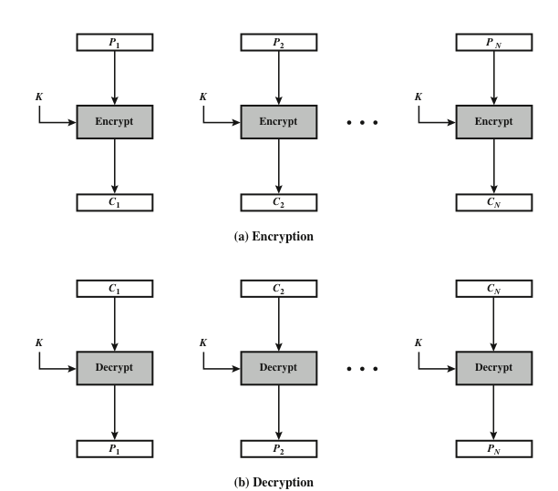
Electronic Code Book mode (ECB)
How to encrypt multiple blocks of a long message?
We need to break up the data into blocks and then encrypt them
The way we do this impacts security
ECB = Each block is encrypted independently of the others
C_{i} = E_{K}(P_{i})
P_{i} = E_{K}⁻¹(C_{i})
Notes:
It can be used in situations where short plaintext blocks are to be encrypted
The simplest mode is the electronic codebook (ECB ) mode, in which plaintext
is handled one block at a time and each block of plaintext is encrypted using the
same key (Figure 7.3). The term codebook is used because, for a given key, there is
a unique ciphertext for every b -bit block of plaintext. Therefore, we can imagine a
gigantic codebook in which there is an entry for every possible b -bit plaintext pattern
showing its corresponding ciphertext.
For a message longer than b bits, the procedure is simply to break the message
into b -bit blocks, padding the last block if necessary. Decryption is performed one
block at a time, always using the same key. In Figure 7.3, the plaintext (padded as
necessary) consists of a sequence of b -bit blocks, P₁ , P₂ , . . . , P_{N} ; the corresponding
sequence of ciphertext blocks is C₁ , C₂ , . . . , C_{N} . We can define ECB mode as
follows.
ECB C_{j} = E(K, Pj) j = 1, . . . , N P_{j} = D(K, Cj₎ j = 1, . . . , N
The ECB method is ideal for a short amount of data, such as an encryption
key. Thus, if you want to transmit a DES or AES key securely, ECB is the appropriate
mode to use.
The most significant characteristic of ECB is that if the same b -bit block of
plaintext appears more than once in the message, it always produces the same
ciphertext.
For lengthy messages, the ECB mode may not be secure. If the message is
highly structured, it may be possible for a cryptanalyst to exploit these regularities.
For example, if it is known that the message always starts out with certain
predefined fields, then the cryptanalyst may have a number of known plaintext–
ciphertext pairs to work with. If the message has repetitive elements with a
period of repetition a multiple of b bits, then these elements can be identified by the
analyst. This may help in the analysis or may provide an opportunity for substituting
or rearranging blocks.

Slide 8
Definition of ECB
Verifying its correctness:
Encryption and decryption are inverse operations if the same key K is used on both sides: d_{K}(C) = d_{K}(e_{K}(P)) = P

Slide 9
ECB advantages/disadvantages
Advantages
Bit errors caused by noisy channels only affect the corresponding block but not succeeding blocks
Encryption/decryption can be done in parallel => high-speed
Disadvantages
ECB is a deterministic encryption scheme
Identical PT blocks produce the same CT blocks
An attacker recognizes if the same message has been sent twice
Notes:
No block synchronization between sender and receiver is required
The same PT blocks produce the same CT blocks
Identical plaintexts are mapped to identical ciphertexts
plaintext blocks are encrypted independently of previous blocks
an attacker may reorder ciphertext blocks which results in valid plaintext

Slide 10

Substitution Attack on ECB
Once a particular plaintext to ciphertext block mapping P_{i} → C_{i} is known, a sequence of ciphertext blocks can easily be manipulated
Suppose an electronic bank transfer
The encryption key between the two banks does not change too frequently
The attacker sends $1 transfers from his account at bank A to his account at bank B repeatedly
He can check for ciphertext blocks that repeat, and he stores blocks 1,3 and 4 of these transfers
He now simply replaces block 4 of other transfers with the block 4 that he stored before
All transfers from some account of bank A to some account of bank B are redirected to go into the attacker’s B account!

Slide 11
Cipher Block Chaining mode (CBC)
There are two main ideas behind the CBC mode:
Previous cipher block is chained with current plaintext block
Ciphertext C_{i} depends not only on block P_{i} but also on ciphertext block C_{i-1}
Any change to a block affects all following ciphertext blocks
The encryption is randomized by using an Initialization Vector (IV)
C₁ = E_{K}(P₁ ⊕ IV)
C_{i} = E_{K}(P_{i} ⊕ C_{i-1})
IV should be a non-secret nonce (number used only once) => IV ensures that the CBC mode becomes a probabilistic encryption scheme, i.e., two encryptions of the same plaintext look entirely different.
Notes:
Encryption (first block): y₁ = e_{k} (x₁ ⊕ IV)
Encryption (general block): y_{i} = e_{k} (x_{i} ⊕ y_{i−1}), i ≥ 2
Decryption (first block): x₁ = e_{k}⁻¹ (y₁) ⊕ IV
Decryption (general block) : x_{i} = e_{k}⁻¹ (y_{i}) ⊕ y_{i−1}, i ≥ 2

Slide 12
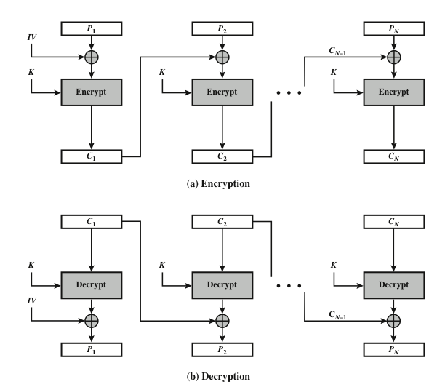
Cipher Block Chaining mode (CBC)
But
Sequential implementation.
Cannot be parallelized (becoz next depends on previous)
If one PT block changes => must re-encrypt all following blocks
Notes:
For the first plaintext block x₁ there is no previous ciphertext
an IV is added to the first plaintext to make each CBC encryption nondeterministic
the first ciphertext y₁ depends on plaintext x₁ and the IV
The second ciphertext y₂ depends on the IV, x₁ and x₂
The third ciphertext y₃ depends on the IV and x₁, x₂ and x₃, and so on

Slide 13
Mathematical definition of CBC

Slide 14
Stream Modes of Operation

Slide 15
Stream Modes of Operation
Use block cipher as some form of pseudo-random number generator
The key stream is computed in a blockwise fashion (instead of bitwise)
The key stream block has the same size as the plaintext block
The random number bits are then XOR’ed with the plaintext (as in stream cipher)
There are three modes that make it possible to convert a block cipher into a stream cipher:
Cipher Feedback (CFB) mode
Output Feedback (OFB) mode
Counter (CTR) mode
Notes:
Each byte of plaintext is XOR-ed with a byte.
Convert block cipher into stream cipher
Output feedback (OFB) mode
Cipher feedback (CFB) mode
Counter (CTR) mode
e taken from a keystream: the result is the ciphertext.
Convert block cipher into stream cipher
Output feedback (OFB) mode
Cipher feedback (CFB) mode
Counter (CTR) mode

Slide 16
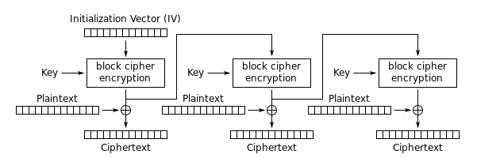
Output Feedback mode (OFB)
It is used to build a stream cipher from a block cipher
The output of the cipher gives us key stream bits S_{i} with which we can use to encrypt plaintext bits using the XOR operation.
Output of the cipher is feed back for next stage
Encryption (first block): S₁ = e_{k} (IV) and C₁ = S₁ ⊕ P₁
Encryption (general block): S_{i} = e_{k} (S_{i−1}) and C_{i} = S_{i} ⊕ P_{i} , i ≥ 2
Decryption (first block): S₁ = e_{k} (IV) and P₁ = S₁ ⊕ C₁
Decryption (general block) : S_{i} = e_{k} (S_{i−1}) and P_{i} = S_{i} ⊕ C_{i} , i ≥ 2
Notes:
synchronous stream cipher

Slide 17
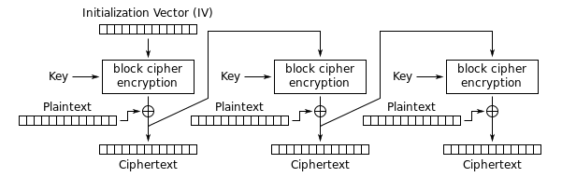
Cipher Feedback mode (CFB)
The key stream S_{i} is generated based the ciphertext C_{i−1}
As a result of IV, the CFB encryption is also nondeterministic
Encryption (first block): C₁ = e_{k} (IV) ⊕ P₁
Encryption (general block): C_{i} = e_{k} (C_{i−1}) ⊕ P_{i} , i ≥ 2
Decryption (first block): P₁ = e_{k} (IV) ⊕ C₁
Decryption (general block) : P_{i} = e_{k} (C_{i−1}) ⊕ C_{i} , i ≥ 2
Notes:
in a blockwise fashion and is also a function of
It uses a block cipher as a building block for a stream cipher (similar to the OFB mode), more accurate name: “Ciphertext Feedback Mode”
Message is added to the output of the block cipher
Result is feed back for next stage (hence name)
asynchronous stream cipher

Slide 18
Counter mode (CTR)
It uses a block cipher as a stream cipher (like the OFB and CFB modes)
Encrypt counter value rather than any feedback value
The input to the block cipher is a counter value (same size as the plaintext block size) which must be different for each plaintext block that is encrypted
S_{i} = E_{K}(CTR_{i})
C_{i} = P_{i} ⊕ S_{i}
The keystream is generated by encrypting a sequence of counter blocks
Unlike CFB and OFB modes, the CTR mode can be parallelized since the 2nd encryption can begin before the 1st one has finished
Desirable for high-speed implementations, e.g., in network routers
Notes:
https://pycryptodome.readthedocs.io/en/latest/src/cipher/classic.html#ctr-mode
Efficiency Can do parallel encryptions in h/w or s/w
Can preprocess in advance of need
Good for bursty high speed links
Random access to encrypted data blocks
Provable security (good as other modes)
But must never reuse key/counter values, otherwise could break
assumes a different value every time the block cipher computes a new key stream block
Although interest in the counter (CTR) mode has increased recently with applications
to ATM (asynchronous transfer mode) network security and IP sec (IP security),
this mode was proposed early on (e.g., [DIFF79]).
Figure 7.7 depicts the CTR mode. A counter equal to the plaintext block
size is used. The only requirement stated in SP 800-38A is that the counter value
must be different for each plaintext block that is encrypted. Typically, the counter
is initialized to some value and then incremented by 1 for each subsequent block
(modulo 2^{b} , where b is the block size). For encryption, the counter is encrypted and
then XORed with the plaintext block to produce the ciphertext block; there is no
chaining. For decryption, the same sequence of counter values is used, with each encrypted
counter XORed with a ciphertext block to recover the corresponding plaintext
block. Thus, the initial counter value must be made available for decryption.
As with the OFB mode, the initial counter value must be a nonce; that is, T₁
must be different for all of the messages encrypted using the same key. Further,
all T_{i} values across all messages must be unique. If, contrary to this requirement, a
counter value is used multiple times, then the confidentiality of all of the plaintext
blocks corresponding to that counter value may be compromised. In particular, if
any plaintext block that is encrypted using a given counter value is known, then
the output of the encryption function can be determined easily from the associated
ciphertext block. This output allows any other plaintext blocks that are encrypted
using the same counter value to be easily recovered from their associated ciphertext
blocks.
One way to ensure the uniqueness of counter values is to continue to increment
the counter value by 1 across messages. That is, the first counter value of the
each message is one more than the last counter value of the preceding message.

Slide 19
Graphical description and Mathematical definition

Slide 20
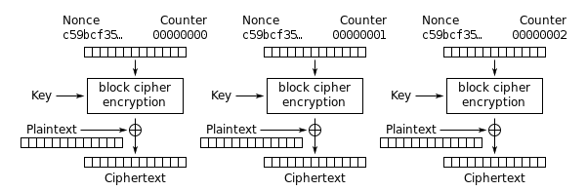
Counter mode (CTR)
A counter block consists of the concatenation of two pieces: a fixed nonce (set at initialization) + a variable counter, which gets increased by 1 for any subsequent counter block.
Notes:
The counter is big endian encoded.

Slide 21
Counter Mode: Discussion
The advantage of Counter mode is that it can be parallelized.
This is because it does not include a feedback.
If we have two cipher modules running in parallel, the first module encrypts CTR₁ and the second one encrypts CTR₂.
This is desirable for applications with high throughput demands.

Slide 22
Summary
Mode | Description
Electronic Codebook (ECB) | Each PT block is encrypted independently using the same key.
Cipher Block Chaining (CBC) | The input to the encryption algorithm is the PT block XOR the CT of previous block C_{i} = E_{K}(P_{i} ⊕ C_{i-1}) With C₁ = E_{K}(P₁ ⊕ IV)
Output Feedback (OFB) | Encryption of the preceding key stream to produce a pseudorandom output, which is XORed with PT block to produce CT block. With S₁ = e_{k} (IV)
Cipher Feedback (CFB) | Encryption the preceding CT block to produce pseudorandom output, which is XORed with PT block to produce CT block. With C₁ = e_{k} (IV) ⊕ P₁
Counter (CTR) | Each block of plaintext is XORed with an encrypted counter. The counter is incremented for each subsequent block. S_{i} = E_{K}(CTR_{i}) C_{i} = P_{i} ⊕ S_{i}

Slide 23
Summary
When using block ciphers to encrypt data larger than one block, you need to pick an operating mode
Each mode of operation has some advantages and disadvantages
Your choice impacts security and performance
The straightforward ECB mode is vulnerable to substitution attack
Several modes turn a block cipher into a stream cipher
The counter mode allows parallelization of encryption and is thus suited for high speed implementations
23
Notes:
There are many different ways to encrypt with a block cipher.

Slide 24
References
Block cipher modes of operation Wikipedia page
http://en.wikipedia.org/wiki/Modes_of_operation

Slide 25
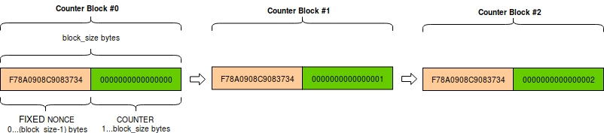
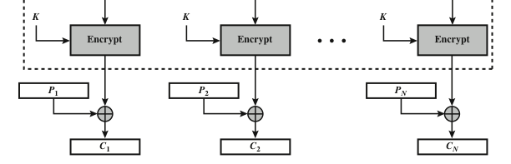
N
25

